Slide 1
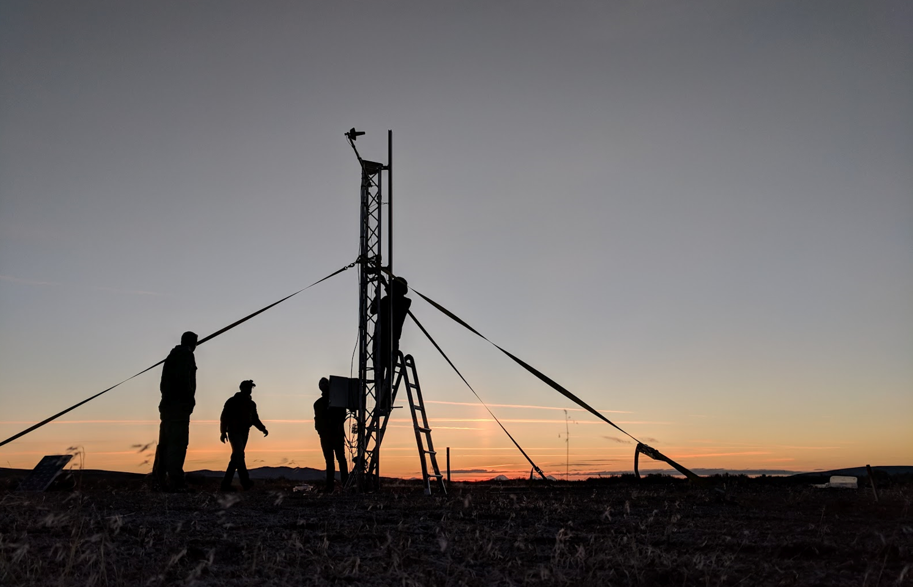
Flight Ready Electric Feed System
Project No. 13
Sponsored by PSAS, PSU, and Oregon NASA Space Grant Consortium

Slide 2

Team Members
PSAS Electric Feed System
Julio Garcia
Philip Wahl
Nick Sheldon
Henry Ju
Jonas Mendoza
Shayli Elrod

Slide 3
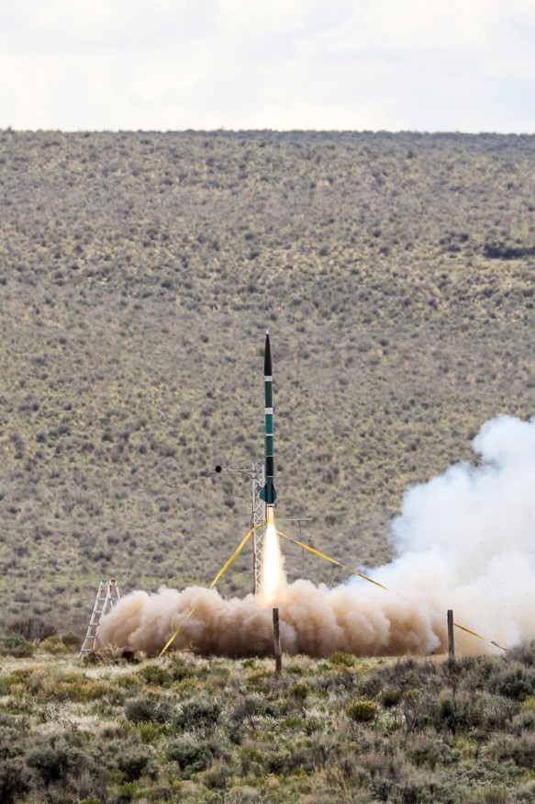
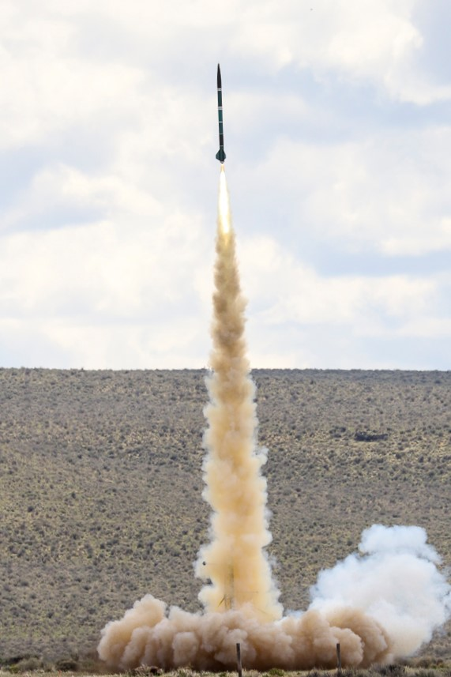
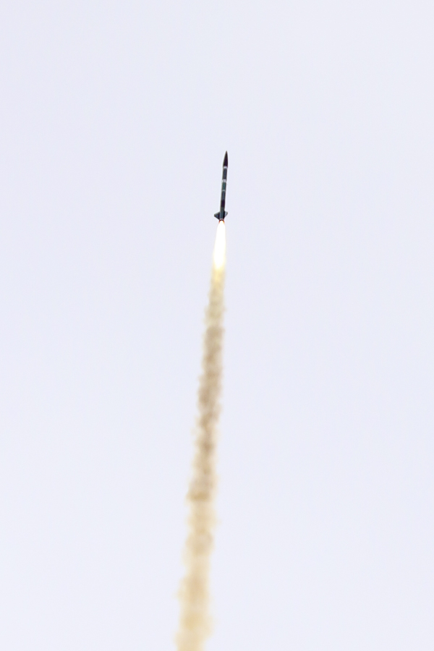
Portland State Aerospace Society
What is PSAS?

Slide 4
Electric Feed System
What is an EFS?
Fuel Tanks
EFS
Control
Motor
Pump
Engine

Slide 5
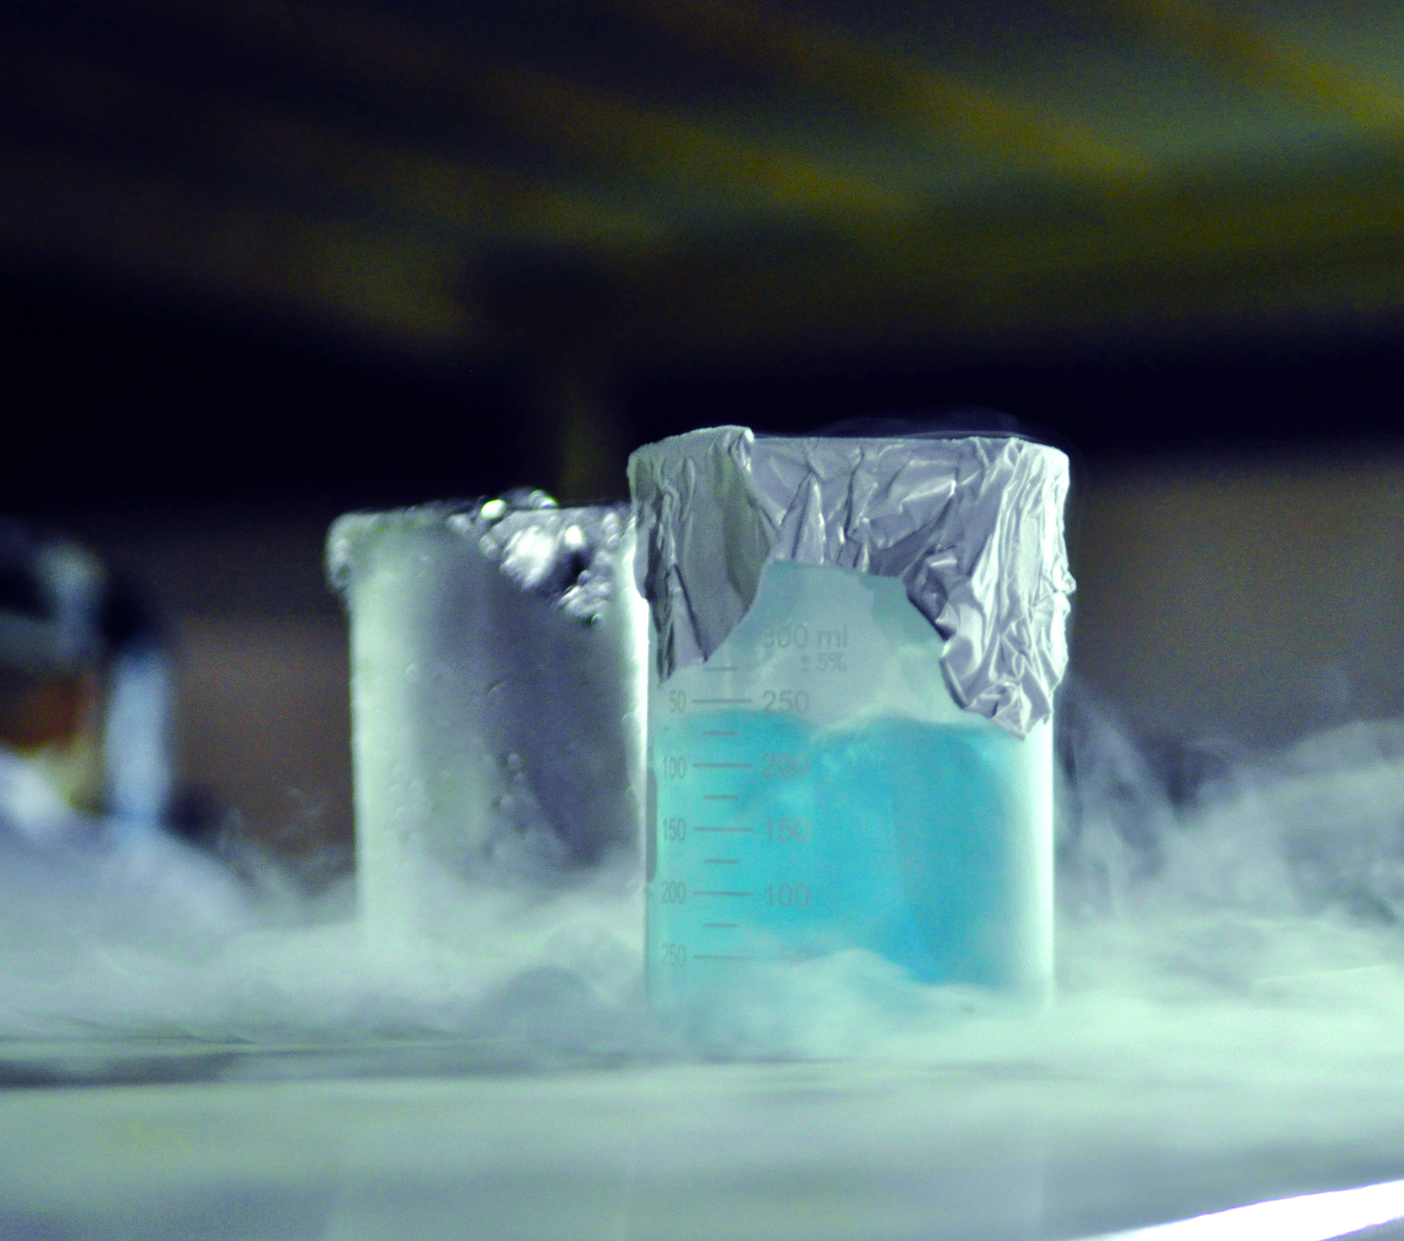
Customer Requirements
PSAS Electric Feed System
Compatibility Requirements
Liquid Oxygen (LOX)
Isopropyl Alcohol
Propellant Safety
Embedded Sensors
Chemical Safety Training for LOX

Slide 6
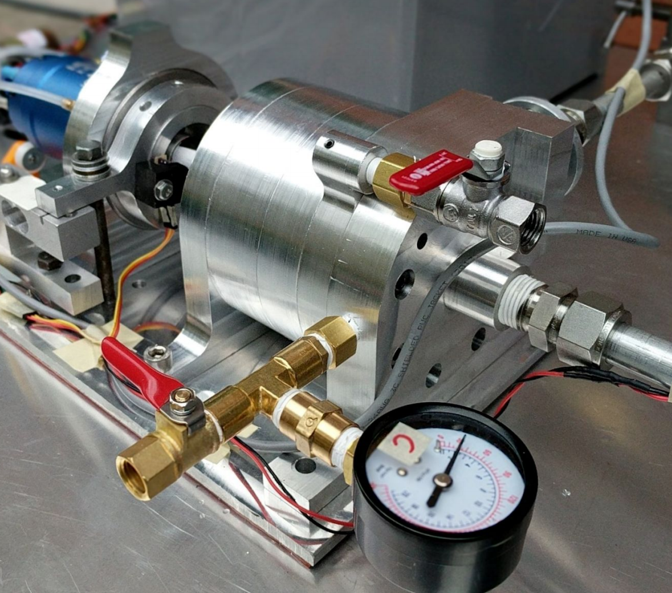
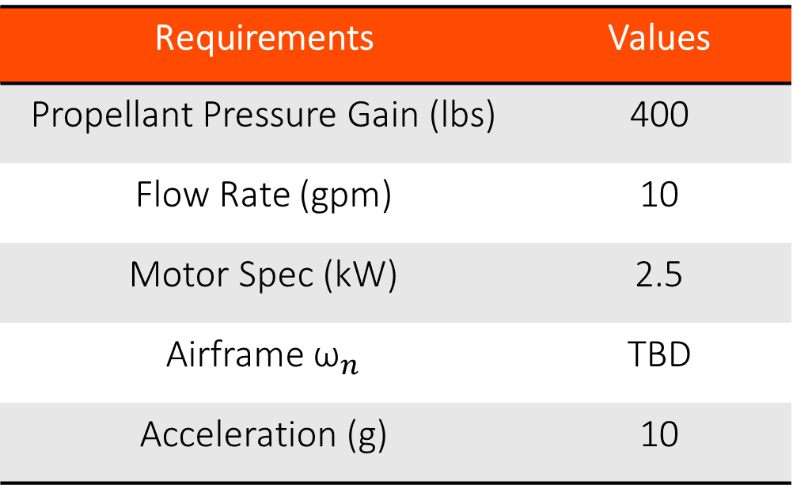
Engineering Requirements
PSAS Electric Feed System
Requirements | Values
Propellant Pressure Gain (lbs) | 400
Flow Rate (gpm) | 10
Motor Spec (kW) | 2.5
Airframe ${\text{ω}}_{n}$ | TBD
Acceleration (g) | 10

Slide 7
Stretch Goals
What does the customer expect?
MUST
Demonstrate
system pumping
during cold
flow analysis
SHOULD
Test system with
LOX and ISO
MAY
Hook up the
system to test
stand

Slide 8
Milestones
PSAS Electric Feed System
December - January
February - March
April - May
June
Design & Concept
Manufacturing
Testing
Completion

